Slide 1
Analyzing multiple factors simultaneously
Compare 1-Factor vs. 2-Factor GLMs
Experimental design for 2-Factor GLM
Outline the types of biological questions that 2_Factor can answer

Slide 2
We have learned an approach to analyze experiments like this:
Drug | Sample size
Drug A | xxxxxxxxxx
Drug B | xxxxxxxxxx
Drug C | xxxxxxxxxx
x= a randomly selected individual experiencing a treatment
= yields an independent growth rate measurement;
sample size = 10 per treatment

Slide 3
We have learned an approach to analyze experiments like this:
Factor
Drug | Sample size
Drug A | xxxxxxxxxx
Drug B | xxxxxxxxxx
Drug C | xxxxxxxxxx
levels
x= a randomly selected individual experiencing a treatment
= yields an independent growth rate measurement;
sample size = 10 per treatment
Notes:
Explain a “Factor” as a “Categorical variable”; i.e., a variance that specifies different categories of one type of variable, e.g., Factor or category may be Drug, and it will specify whether individuals had Drug A vs. B vs. C

Slide 4
One factor design; loosely called “1-way ANOVA”
Factor
Drug | Sample size
Drug A | xxxxxxxxxx
Drug B | xxxxxxxxxx
Drug C | xxxxxxxxxx
levels
x= a randomly selected individual experiencing a treatment
= yields an independent growth rate measurement;
sample size = 10 per treatment
Notes:
Explain a “Factor” as a “Categorical variable”; i.e., a variance that specifies different categories of one type of variable, e.g., Factor or category may be Drug, and it will specify whether individuals had Drug A vs. B vs. C

Slide 5
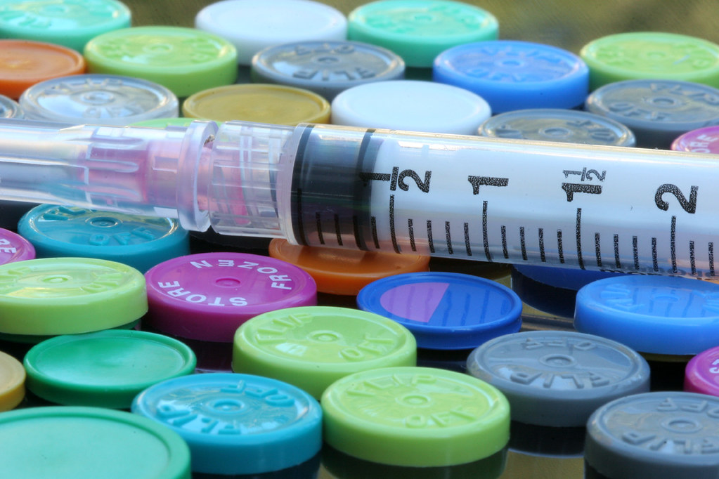
Imagine we also want to examine drug concentration
Multiple small experiments vs. One large experiment?
Concentration | Drug
 | A
Low | XXXXX
High | XXXXX
 | B
Low | XXXXX
High | XXXXX
 | C
Low | XXXXX
High | XXXXX
“all in a day’s work” by Dawn Huczek is licensed CC BY 2.0

Slide 6
Perspective 1 on this experiment
One factor
Factor
levels
x = a randomly selected individual experiencing a treatment
= an independent measurement
sample size = 5 per level

Slide 7
Perspective 2 on this experiment
Concentration
Drug | Low | High
A | XXXXX | XXXXX
B | XXXXX | XXXXX
C | XXXXX | XXXXX
x= a randomly selected individual experiencing a treatment
= an independent measurement
sample size = 5 per treatment combination

Slide 8
Perspective 2 on this experiment
Two factors, fully crossed design
Factor
levels
Concentration
Factor
Drug | Low | High
A | XXXXX | XXXXX
B | XXXXX | XXXXX
C | XXXXX | XXXXX
levels
x= a randomly selected individual experiencing a treatment
= an independent measurement
sample size = 5 per treatment combination

Slide 9
Perspective 2 on this experiment
Two factors, fully crossed design
Factor
levels
Concentration
Factor
Drug | Low | High
A | XXXXX | XXXXX
B | XXXXX | XXXXX
C | XXXXX | XXXXX
levels
x= a randomly selected individual experiencing a treatment
= an independent measurement
sample size = 5 per treatment combination

Slide 10
1-Factor vs. 2-Factor approaches for fully-crossed design
Concentration
Drug | Low | High
A | XXXXX | XXXXX
B | XXXXX | XXXXX
C | XXXXX | XXXXX
The best approach depends on the question your experiment aims to answer.
But, questions that are best answered by a 1-Factor analysis are unlikely to lead to a fully-crossed design.

Slide 11
What questions can a fully-cross factored design answer?
Concentration
Drug | Low | High
A | XXXXX | XXXXX
B | XXXXX | XXXXX
C | XXXXX | XXXXX
Does Drug type, irrespective of Concentration, affect the
measurement?
Does Concentration, irrespective of Drug type, affect the
measurement?
Does any effect of Drug on the measurement depend on Concentration (and vice versa)?
Commonly expect interactions in biology. e.g., does a drug affect sexes differently? Does a gene’s effect on survival depend on environment?

Slide 12
Take-home messages for analysis of
fully cross-factored designs
Similarities between 1-Factor and multi-Factor analyses:
Approach to analysing these designs can be very similar
Similar assumptions and methods to check them
We will teach by example - new ideas to watch out for:
Multiple factors introduce additional options to calculate SS (not addressed here); use new command, Anova(), to calculate p-values
Interactions
Can address many hypotheses (e.g., post-hoc tests) that depend an experiment’s goals; we cannot illustrate all possibilities. We will illustrate some examples.
Notes:
For this, “Can address many hypotheses (e.g., post-hoc tests) that depend an experiment’s goals; we cannot illustrate all possibilities”, NOTE that the student needs to think carefully about the specific questions they hope to answer with their data. The examples we consider will provide a good foundation to build for additional analyses.

Slide 13
Notes:
Factors vs levels

