Slide 1
Which of the following is NOT an assumption of General Linear Models?
The data are independent
Homogeneity of variance
Data were selected randomly from the population of interest and / or subjects allocated randomly to treatments
The raw data are normally distributed
Notes:
Answer: D. The assumption of normality refers to the residuals, not the raw data

Slide 2
Place these assumptions in order of decreasing importance:
The data are independent
Homogeneity of variance
Data were selected randomly from the population of interest
iv) The residuals are normally distributed
iii, i, ii, iv
iv, ii, i, iii
iii, ii, i, iv
ii, iii, iv, i
Notes:
A

Slide 3
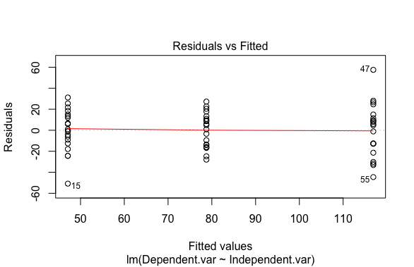
This figure:
Displays the relationship between Residual values and Fitted values
Can be used to test the assumption of equal variance
Can be used to test the assumption of normally distributed residuals
Is less useful than a Shaprio-Wilks test to assess the assumption of equal variance
More than one of these options is correct
Notes:
A and B are correct (so, E is also correct)
Note that D is wrong in 2 ways: visualizing residuals is better than formal tests to assess whether data meet assumptions, AND a Shapiro-Wilks test can be used to test for normality (not equal variance)

Slide 4
This figure suggests:
The data do not meet the assumption of equal variance
The data meet the assumption of equal variance
The data do not meet the assumption of normally distributed residuals
The data meet the assumption of normally distributed residuals
Notes:
B – notice how the ‘vertical spread’ of the residuals is relatively similar in the three vertical columns of points (and recall that the 3 columns of residuals correspond to the various treatment groups).

Slide 5
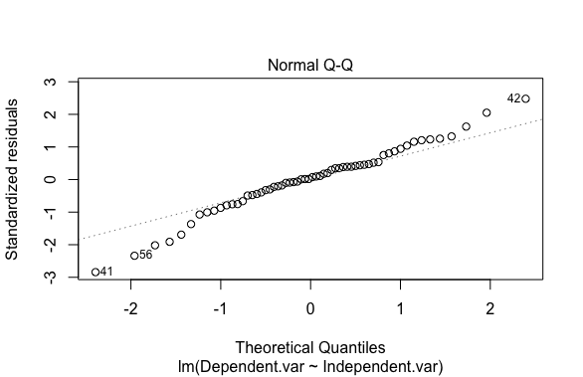
This figure suggests:
The data do not meet the assumption of equal variance
The data meet the assumption of equal variance
The data do not meet the assumption of normally distributed residuals
The data meet the assumption of normally distributed residuals
Notes:
D (not perfect, but likely good enough)

Slide 6
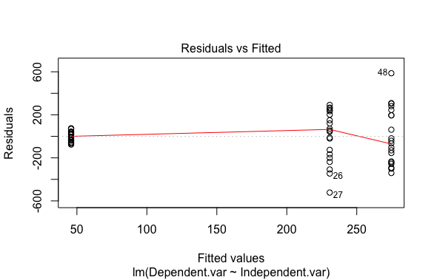
This figure suggests:
The data do not meet the assumption of equal variance
The data meet the assumption of equal variance
The data do not meet the assumption of normally distributed residuals
The data meet the assumption of normally distributed residuals
Notes:
A – notice how the spread of the residuals is quite different between the group on the left compared to the other 2 columns of points.

Slide 7
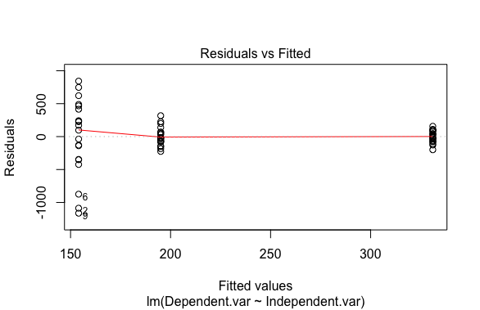
This figure suggests:
The data do not meet the assumption of equal variance
The data meet the assumption of equal variance
The data do not meet the assumption of normally distributed residuals
The data meet the assumption of normally distributed residuals
Notes:
A – as in the previous slide, but in this case the trend is reversed: we see the residuals becoming closer together as we move from left to right.

Slide 8
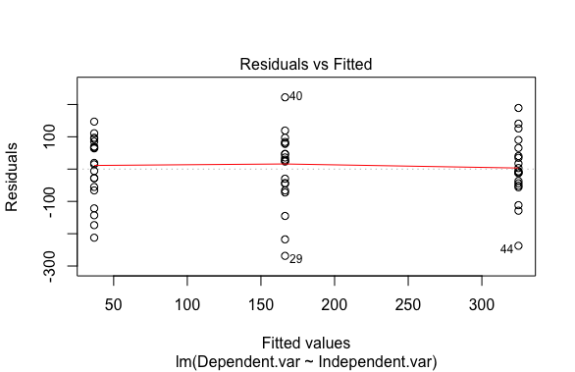
This figure suggests:
The data do not meet the assumption of equal variance
The data meet the assumption of equal variance
The data do not meet the assumption of normally distributed residuals
The data meet the assumption of normally distributed residuals
Notes:
B

Slide 9
Why is this Quiz giving more attention to the assumption of equal variance than to normality?
Everyone knows how important normality is, so there’s no point in wasting your time
Homogeneity of variance is a more important assumption than normality
Equal variance is less important that homogeneous variances
The teacher is just too lazy to make another slide
Notes:
B

Slide 10
Where did “Student”, who invented the Student t-test, work?
Student did not work; he was independently wealthy
At a life insurance company
At a betting company
Guinness
Notes:
D

Slide 11
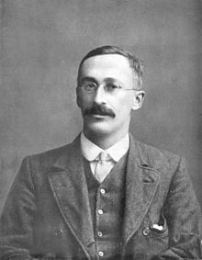
William Sealy Gosset worked at Guinness. A.K.A. “Student”
“This assumption [normal distribution] is accordingly made in the present paper, so that its conclusions are not strictly applicable to populations known not to be normally distributed; yet it appears probable that the deviation from normality must be very extreme to lead to serious error (Student 1908).”
User Wujaszek on pl.wikipedia - scanned from Gosset's obituary in Annals of Eugenics
Notes:
This quote from the original paper on the t-test indicates that we’ve known for over 100 years that t-tests are relatively robust to violation of normality – the same is true for GLM’s (within reason).

Slide 12
Which of the following is not a likely source of non-independence?
Sampling study subjects randomly
Studying multiple individuals from the same family
Measuring individuals multiple times
Housing study subjects in the same environment (e.g., same cage)
Notes:
A

Slide 13
Design 1 Design 2
Treatment 1
A B C D E F G
A A B B C C
Treatment 2
H I J K L M N
D D E E F F
Treatment 3
O P Q R S T
G G H H I I
Measurements from an individual subject share a letter
Design 1 has potential for non-independence (pseudo-replication)
Design 2 has potential for non-independence (pseudo-replication)
Design 1 & 2 have potential for non-independence (pseudo-replication)
Neither Design has potential for non-independence
Notes:
B – Notice that Design 2 has multiple non-independent measurements *within* treatments (e.g., the 2 A’s within Treatment 1). If we don’t analyze these data appropriately, pseudo-replication will occur and our p-values may be smaller than they should be (as will SE’s for effect sizes).

Slide 14
Design 1 Design 2
Treatment 1
A B C D E F G
A B C D E F
Treatment 2
H I J K L M N
A B C D E F
Treatment 3
O P Q R S T
A B C D E F
Measurements from an individual subject share a letter
Design 1 has potential for pseudo-replication
Design 2 has potential for pseudo-replication
Design 1 & 2 have potential for pseudo-replication
Neither Design has potential for pseudo-replication (given the information provided)
Notes:
D

Slide 15
How might we deal with the
non-independence here?
Treatment 1
A A B B C C
Use averages (per letter)
Delete one data point per letter
Shuffle the data among treatments
Use a statistical model that
accounts for non-independence
Treatment 2
D D E E F F
Treatment 3
G G H H I I
Notes:
A & D. We could also do B, but this would be a waste (and therefore possibly unethical).

Slide 16
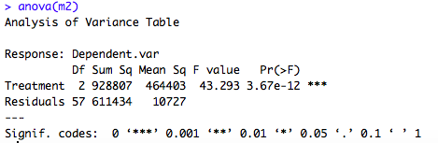
The results above are from an experiment involving 6 mice and
3 treatments. Do the results indicate pseudo-replication?
Yes
No
Impossible to say from the information provided
Notes:
A. How do we know? The df (degrees of freedom) for the residuals is greater than the number of subjects. The df for the residuals gives an indication of the number of measurements. The df here suggests that we have 60 measurements from 6 mice; this implies we have, on average 10 measurements per mouse. Therefore, even if each mouse was measured in all treatments, we still expect 3 about measurements per mouse per treatment. i.e., we must have multiple measurements from a given subject within a treatment, and this violates the assumption of independence.

Slide 17
What transformation might be useful to remedy the unequal variance seen here?
Arcsine square-root
Square-root
Log
Add 10
Notes:
Most likely C, maybe B. These are helpful when the variance increases with the mean, which is indicated by this figure (i.e., notice how the spread among the residuals (the variance) increases as we move from lecf to right (i.e., as the mean (Fitted) values for each treatment groups get larger)).

Slide 18
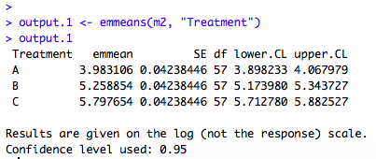
How is this output useful?
The output indicates whether the residual meet the assumptions of the model
It provides estimates of effect size with their 95% CI’s; this helps to interpret a plausible range of sizes of effects.
It provides a measure of effect size and SE for the effect size; the effect size helps to understand the size of a change in a biological trait; the SE can be useful for future meta-analyses that might include our data.
It indicates (marginal) means for each treatment, along with their SE and 95% CI’s; this helps to describe the data.
Notes:
D

Slide 19
On which scale are these results reported?
Square-root scale
Log scale
Original (‘response’) scale
Impossible to know from the information provided
Notes:
B – you can see this from the output, where it says, “Results are given in the log (not the response) scale.”

Slide 20
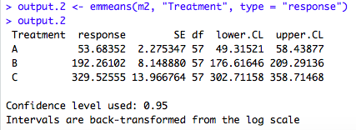
On what scale are the above results reported? And, what do we need to be careful of when interpreting these results?
Original data scale; means are generalized means, not arithmetic means
Log scale; means are generalized means, not arithmetic means
Original scale; means are on arithmetic scale, not generalized
Log scale; must back-transform in order to facilitate interpretation
Notes:
A – again, the model output tells us the data are back-transformed. And, we’ve learned that these back-transformed values are generalized means (not arithmetic means). In the case of log-transformed data, like we have here, the ‘generalized means’ are called ‘geometric means’ (google ‘geometric mean’ for a definition)

Slide 21
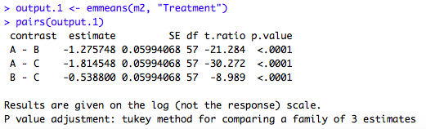
How is this output useful?
The output indicates whether the residual meet the assumptions of the model
It provides estimates of effect size with their 95% CI’s; this helps to interpret a plausible range of sizes of effects.
It provides a test of whether pairs of treatment means differ
It provides a measure of effect size (with SE for each effect size); the effect size helps to understand the size of a change in a biological trait.
It indicates (marginal) means for each treatment, along with their SE and 95% CI’s; this helps to describe the data.
Notes:
C (p-value) & D (‘estimate’ and ‘SE’). Note, however, that the output indicates that the results are on the log-scale.

Slide 22
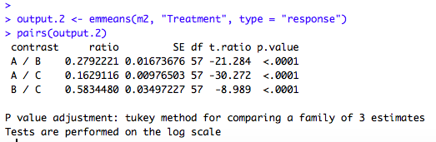
The ‘contrast’, above, is expressed as a ratio. If the mean values (A, B or C) differ from one another, the ratio:
Will be less than 10
Will be greater than 0
Will be greater than 1
Will differ from 1
Notes:
D (A, B and C are wrong because they are too limiting)

Slide 23
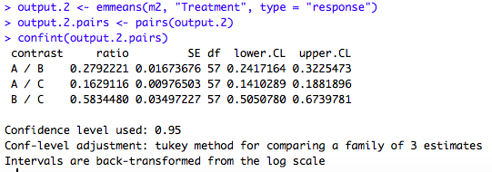
How is this output useful?
The output indicates whether the residual meet the assumptions of the model
It provides estimates of effect size with their 95% CI’s; this helps to interpret a plausible range of sizes of effects.
It provides a test of whether pairs of treatment means differ.
It indicates (marginal) means for each treatment, along with their SE and 95% CI’s; this helps to describe the data.
Notes:
B. But also ‘C’, because we can use the 95% CI’s (given by lower.CL and upper.CL) to determine whether the ratio in the column, ‘contrast,’ differs from 1 [note that this is theratio of the means of two treatments]. If the 95% CI’s do not include the value 1, then this implies that (at a level of p < 0.05) we have evidence that the ratio differs from 1, which further implies that the means of the treatments in the ratio may differ (at level p<0.05).

Slide 24
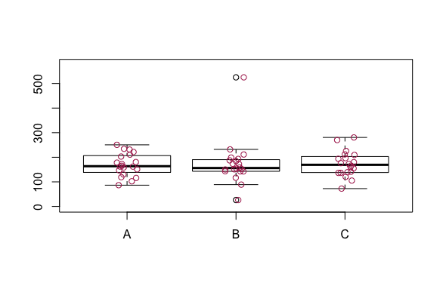
The figure above includes an ‘outlier’. When analyzing these data, we should:
Keep the outlier because it is a ‘real’ data point
Check whether the outlier is the result of an error in the experiment; if so, delete it
Omit the outlier because it will likely affect the results
All of the above
Notes:
D; [DON’T PANIC – WE DID NOT COVER THIS IN VIDEOS – I INCLUDED THIS QUESTION AS A BONUS TOPIC] First we check whether the outlier is a mistake (e.g., if its value is impossible (e.g., a height value that is negative) then it must be a mistake); if we can prove that it is a mistake then remove it from the dataset.
If we cannot prove that it is an error, then analyze the data twice: once with and once without the outlier. If the conclusions from the two analyses are generally similar then we can report the results from the complete dataset and note that removing the outlier does not alter interpretation. If the two analyses reach different conclusions then report both results to allow the reader to decide.

Slide 25
What do we do if our data violate an assumption in a serious way and transformation does not fix the problem?
Perform the analysis with the violated assumption anyway but tell the reader the situation
Find an alternative way to analyze the data, e.g., a different type of statistical approach (e.g., randomization test)
Put the data aside and think
Quit science and sulk.
Notes:
B or C.

